Slide 1
Snowballing Tool
https://github.com/JoaoFelipe/snowballing
João Felipe Pimentel

Slide 2
Snowballing
Search approach for systematic literature review
Start set: {A1}
A1

Slide 3
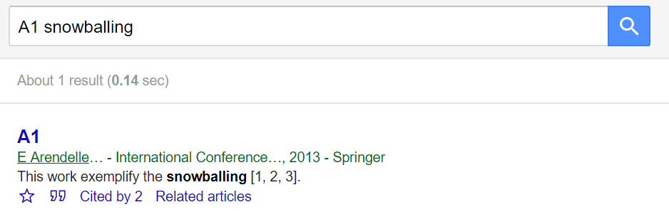
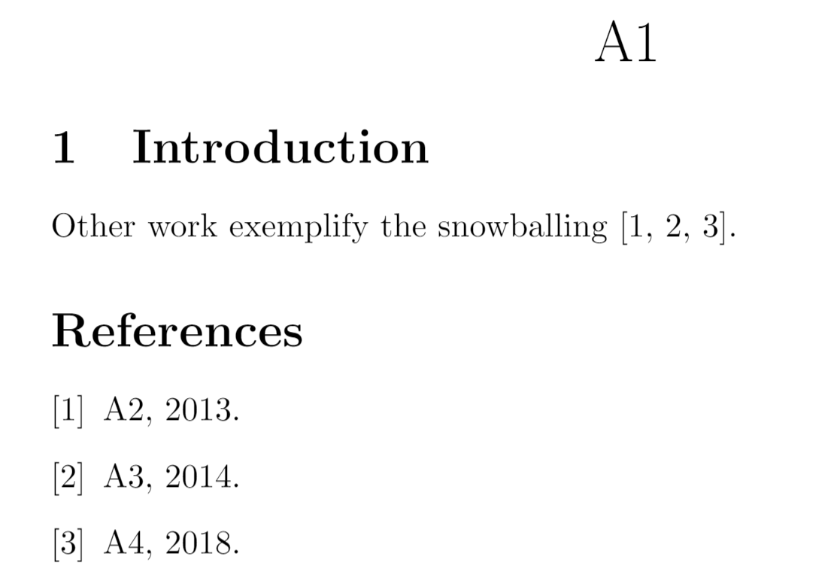
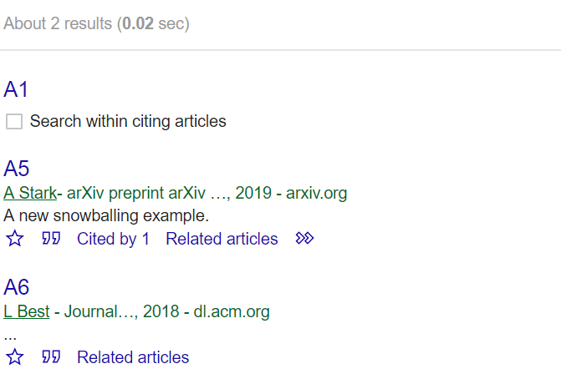
Citations
A2
A3
A1
A5
A4
A6

Slide 4
Backward Snowballing
Which papers where cited by A1 and are related?
A1
A3
A5
A6
A2

Slide 5
Annotations
“A3 approaches the issue by...”
“A1 cites A3 when it describes ...”
A1
A3
A5
A6
A2
“A2 is not related due to ...”

Slide 6
Forward Snowballing
Which papers cite A1 and are related?
A3
A1
A5
A2
A6

Slide 7
Other Annotation Types
“I finished A1 on 2019-04-02”
A3
A1
“A5 may not be too related. I will
leave it marked for reevaluation”
A5
A2
A6

Slide 8
Continuing the process
A1 is complete, but A3 and A5 also have references and citations
A3
A1
A7
A8
A5
A9
A2
A6

Slide 9
Backward
A1
A3
A5
A7
A9
A8
A2
A6

Slide 10
Forward
A1
A3
A5
A7
A8
A2
A6
A9

Slide 11
References and Citations
A1
A3
A5
A7
A10
A8
A2
A6
A9

Slide 12
Stop Condition
No new related reference nor related citation
A1
A3
A5
A7
A10
A8
A2
A6
A9

Slide 13
Challenges
Laborious and repetitive process
After hundreds of papers, it gets hard to remember all discarded
It is good to record all visited papers and not only the related ones
The recording must be easy, consistente, and extensible
Searches and analyses must be flexible for querying the records

Slide 14
Tool
Set of scripts and Jupyter Notebooks
Developed during a snowballing process to automatize and support the process
Some scripts are related to the search/snowballing process by itself
Others are related to the analysis process
The tool is divided into two parts:
Generic library
Project workspace

Slide 15
Getting Started
Install the generic library
$ pip install snowballing
Install geckodriver (https://github.com/mozilla/geckodriver/releases)
I extract it in the Firefox directory, but I’m not sure it is mandatory: C:\Program Files\Mozilla Firefox
Add the directory to the PATH
Install graphviz and add it to the PATH
Start a new project:
$ snowballing start <name>

Slide 16



Project Structure
database - Snowballing data storage
files - Papers’ PDF storage
notebooks - Analysis Notebooks
.gitignore - Ignores the files directory and Python cache files
Backward.ipynb - Supports Backward Snowballing
Forward.ipynb - Supports Forward Snowballing
Index.ipynb - Describes the Project Structure
Insert.ipynb - Supports the insertion of papers from BibTex
Progress.ipynb - Monitors the Snowballing progress
SearchScholar.ipynb - Supports the insertion of papers from Scholar
Validate.ipynb - Validates and updates the insertions

Slide 17
Project Structure
database - Snowballing data storage
files - Papers’ PDF storage
notebooks - Analysis Notebooks
.gitignore - Ignores the files directory and Python cache files
Backward.ipynb - Supports Backward Snowballing
Forward.ipynb - Supports Forward Snowballing
Index.ipynb - Describes the Project Structure
Insert.ipynb - Supports the insertion of papers from BibTex
Progress.ipynb - Monitors the Snowballing progress
SearchScholar.ipynb - Supports the insertion of papers from Scholar
Validate.ipynb - Validates and updates the insertions

Slide 18
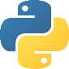
database Structure
__init__.py - Basic configuration
places.py - Stores publication places
groups - Stores approaches. Ignore this for the search phase
work - Stores papers
y2008.py - Papers from 2008. Remove it
Sample Files
y2014.py - Papers from 2014. Remove it
y2015.py - Papers from 2015. Remove it
y9999.py - Papers without year. Do not remove it
citations - Stores citations. A file for each related work
murta2014a.py - Sample file. Remove it

Slide 19
places.py Source Code
from snowballing.models import Place, DB
from snowballing.common_places import *
IPAW = conference("IPAW", "International Provenance and Annotation Workshop")
CSUR = journal("CSUR", "ACM Computing Surveys")
arXiv = DB(Place("arXiv", "arXiv", "Archive"))

Slide 20
y2014.py Source Code
from datetime import datetime
from snowballing.models import *
from ..places import *
murta2014a = DB(WorkSnowball(
2014, "noWorkflow: capturing and analyzing provenance of scripts",
display="noWorkflow",
authors="Murta, Leonardo and Braganholo, Vanessa and Chirigati, Fernando and Koop, David and Freire, Juliana",
place=IPAW,
))

Slide 21
y2014.py Source Code
config.CLASSES no __init__.py:
Work: inserted, but with no decision WorkNoFile: file not found
WorkLang: in another language
WorkUnrelated: unrelated paper
WorkOk: considered, but before the backward WorkSnowball: related, after backward
from datetime import datetime
from snowballing.models import *
from ..places import *
murta2014a = DB(WorkSnowball(
2014, "noWorkflow: capturing and analyzing provenance of scripts",
display="noWorkflow",
authors="Murta, Leonardo and Braganholo, Vanessa and Chirigati, Fernando and Koop, David and Freire, Juliana",
place=IPAW,
))
var name
snowballing state
Name for the analyses
Publication place. Refers a variable from places.py

Slide 22
y2014.py Source Code
from datetime import datetime
from snowballing.models import *
from ..places import *
murta2014a = DB(WorkSnowball(
2014, "noWorkflow: capturing and analyzing provenance of scripts",
display="noWorkflow",
authors="Murta, Leonardo and Braganholo, Vanessa and Chirigati, Fernando and Koop, David and Freire, Juliana",
place=IPAW,
example="1",
todo="remove this example",
analysis="""graph-based: summarization of the activation graph;
diff-based: basic attributes comparison;
query-based: queries""",
))

Slide 23
y2014.py Source Code
from datetime import datetime
from snowballing.models import *
from ..places import *
murta2014a = DB(WorkSnowball(
2014, "noWorkflow: capturing and analyzing provenance of scripts",
display="noWorkflow",
authors="Murta, Leonardo and Braganholo, Vanessa and Chirigati, Fernando and Koop, David and Freire, Juliana",
place=IPAW,
aliases=[(2015, "noWorkflow: Capturing and Analyzing Provenance of Scripts ", "Chirigati, Fernando and Koop, David and Freire, Juliana")],
snowball=datetime(2017, 3, 6),
file="murta2014a.pdf",
citation_file="murta2014a", ))

Slide 24
y2014.py Source Code
from datetime import datetime
from snowballing.models import *
from ..places import *
murta2014a = DB(WorkSnowball(
2014, "noWorkflow: capturing and analyzing provenance of scripts",
display="noWorkflow",
authors="Murta, Leonardo and Braganholo, Vanessa and Chirigati, Fernando and Koop, David and Freire, Juliana",
place=IPAW,
scholar="http://scholar.google.com/scholar?cites= 5458343950729529273&as_sdt=2005&sciodt=0,5&hl=en",
scholar_id="ucciVefuv0sJ",
cluster_id="5458343950729529273",
scholar_ok=True,
))

Slide 25
y2014.py Source Code
from datetime import datetime
from snowballing.models import *
from ..places import *
murta2014a = DB(WorkSnowball(
2014, "noWorkflow: capturing and analyzing provenance of scripts",
display="noWorkflow",
authors="Murta, Leonardo and Braganholo, Vanessa and Chirigati, Fernando and Koop, David and Freire, Juliana",
place=IPAW,
local="Cologne, Germany",
pp="71--83",
entrytype="inproceedings",
organization="Springer",
editor="Ludaescher, Bertram and Plale, Beth",
))

Slide 26
citations/*.py Source Code
from snowballing.models import *
from snowballing import dbindex
dbindex.last_citation_file = dbindex.this_file(__file__)
from ..work.y2008 import freire2008a
from ..work.y2014 import murta2014a
from ..work.y2015 import pimentel2015a
DB(Citation(
murta2014a, freire2008a,
))

Slide 27
citations/*.py Source Code
from snowballing.models import *
from snowballing import dbindex
dbindex.last_citation_file = dbindex.this_file(__file__)
from ..work.y2008 import freire2008a
from ..work.y2014 import murta2014a
from ..work.y2015 import pimentel2015a
DB(Citation(
murta2014a, freire2008a, ref="5",
contexts=[
"There are two types of provenance for scientific workflows: prospective and retrospective [5]. Prospective provenance describes the structure of the experiment and corresponds to the workflow definition, the graph of the activities, and their associated parameters. Retrospective provenance captures the steps taken during the workflow execution, and while it has similar (graph) structure, it is constructed using information collected at runtime, including activities invoked and parameter values used, intermediate data produced, the execution start and end times, etc"
],
))

Slide 28
Project Structure
database - Snowballing data storage
files - Papers’ PDF storage
notebooks - Analysis Notebooks
.gitignore - Ignores the files directory and Python cache files
Backward.ipynb - Supports Backward Snowballing
Forward.ipynb - Supports Forward Snowballing
Index.ipynb - Describes the Project Structure
Insert.ipynb - Supports the insertion of papers from BibTex
Progress.ipynb - Monitors the Snowballing progress
SearchScholar.ipynb - Supports the insertion of papers from Scholar
Validate.ipynb - Validates and updates the insertions

Slide 29
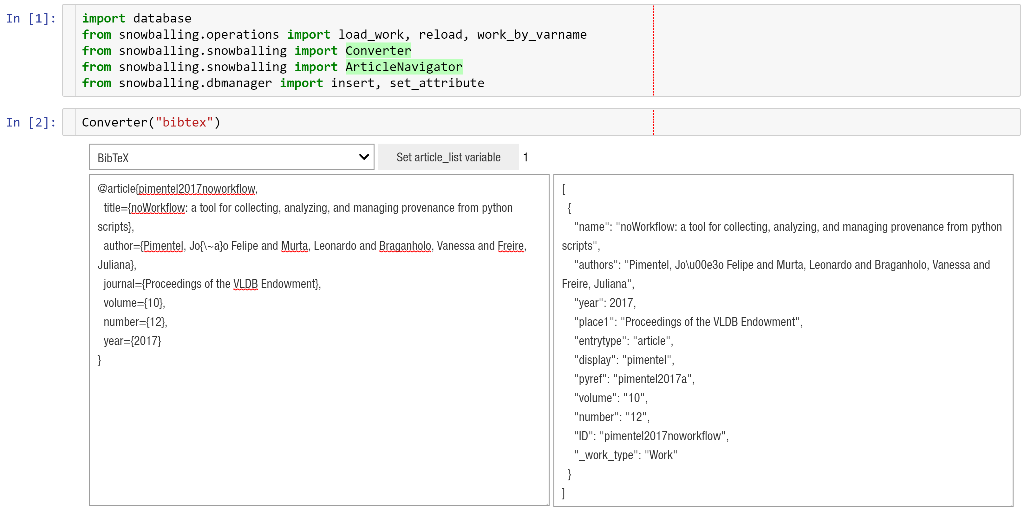
Insert.ipynb 1/4
1
2
3
4
5

Slide 30
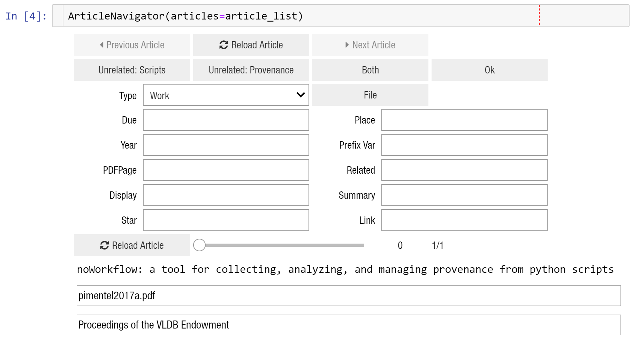
Insert.ipynb 2/4
1
2
4
If this field shows up, the publication places was not detected Edit places.py to add it or write the varname on the Place field
3

Slide 31
places.py Source Code
from snowballing.models import Place, DB
from snowballing.common_places import *
IPAW = conference("IPAW", "International Provenance and Annotation Workshop")
CSUR = journal("CSUR", "ACM Computing Surveys")
VLDB = conference("VLDB", "VLDB Endowment")
arXiv = DB(Place("arXiv", "arXiv", "Archive"))

Slide 32
Insert.ipynb 3/4
1
config.FORM_BUTTONS
from
__init__.py
2
config.FORM_TEXT_FIELDS

Slide 33
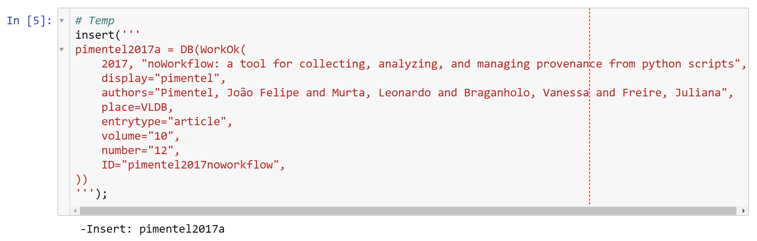
Insert.ipynb 4/4
1
2

Slide 34
Project Structure
database - Snowballing data storage
files - Papers’ PDF storage
notebooks - Analysis Notebooks
.gitignore - Ignores the files directory and Python cache files
Backward.ipynb - Supports Backward Snowballing
Forward.ipynb - Supports Forward Snowballing
Index.ipynb - Describes the Project Structure
Insert.ipynb - Supports the insertion of papers from BibTex
Progress.ipynb - Monitors the Snowballing progress
SearchScholar.ipynb - Supports the insertion of papers from Scholar
Validate.ipynb - Validates and updates the insertions

Slide 35
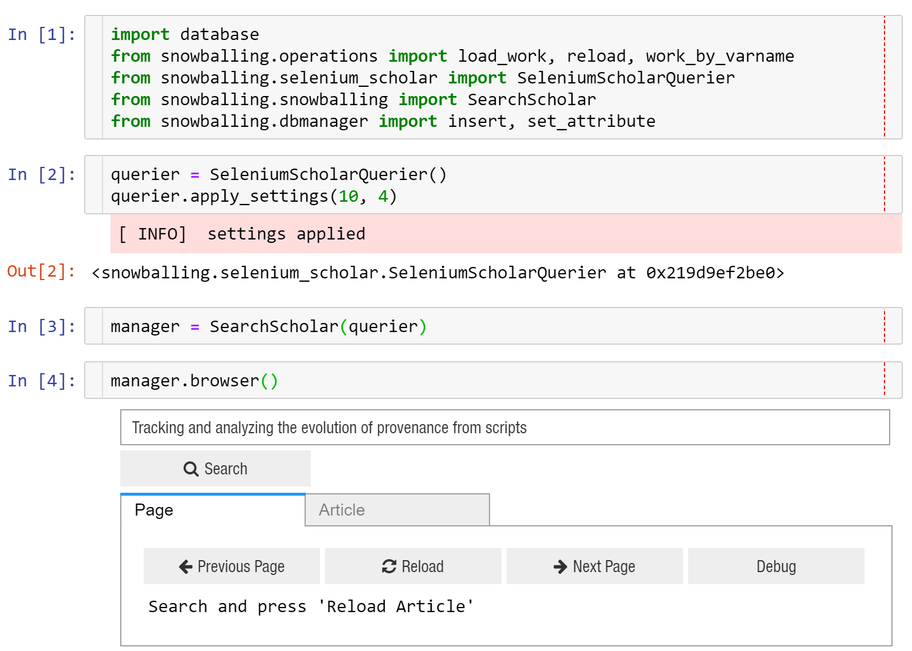
SearchScholar.ipynb 1/3
1
2
3
4
5
6

Slide 36
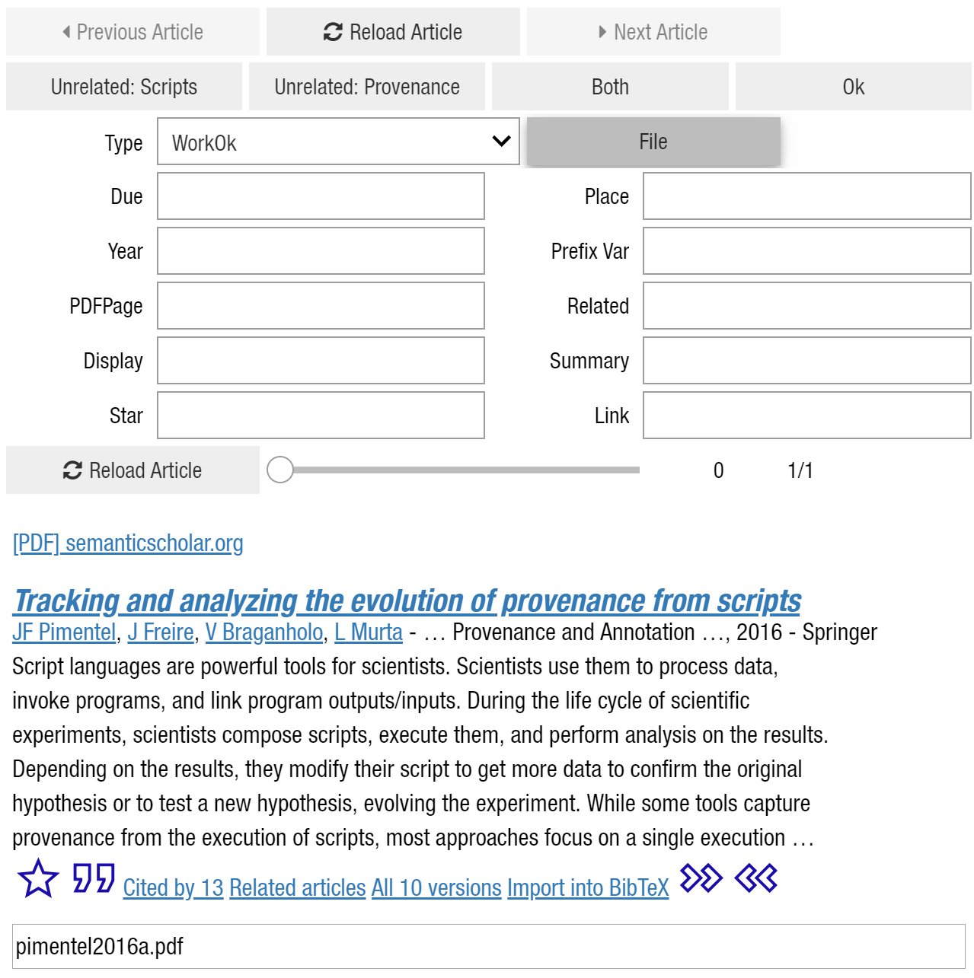
SearchScholar.ipynb 2/3
2
1
3

Slide 37
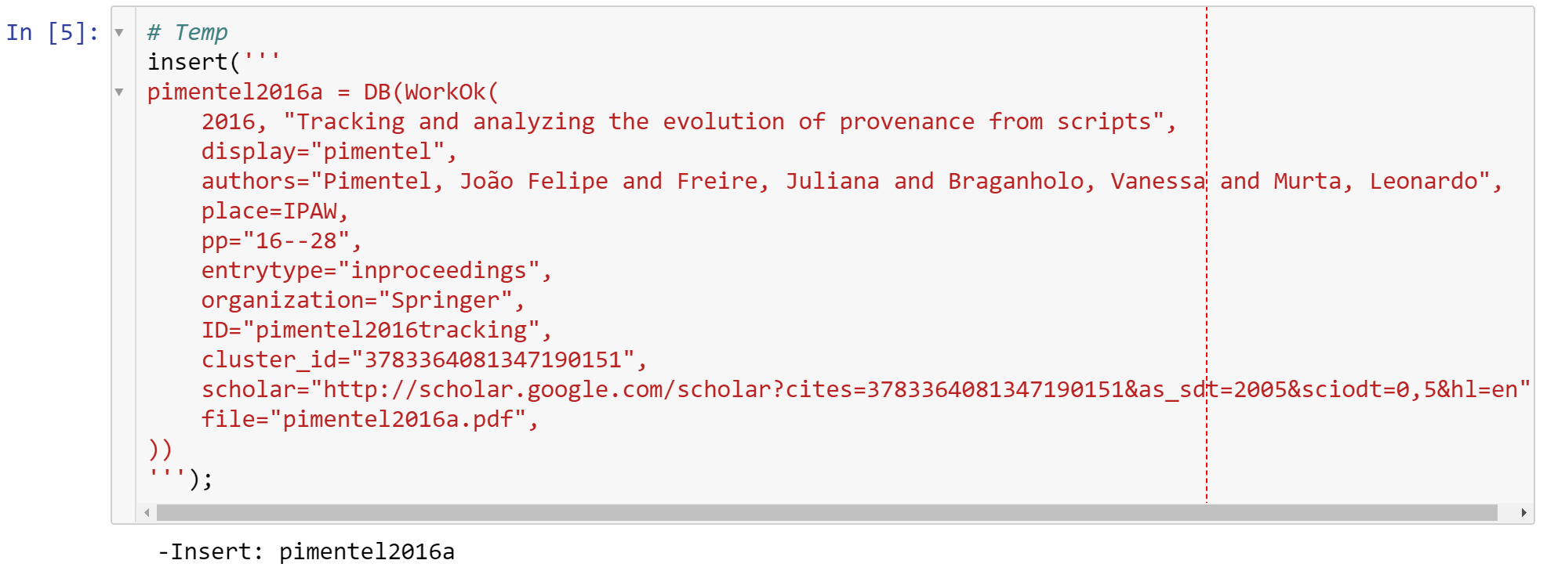
SearchScholar.ipynb 3/3

Slide 38
Project Structure
database - Snowballing data storage
files - Papers’ PDF storage
notebooks - Analysis Notebooks
.gitignore - Ignores the files directory and Python cache files
Backward.ipynb - Supports Backward Snowballing
Forward.ipynb - Supports Forward Snowballing
Index.ipynb - Describes the Project Structure
Insert.ipynb - Supports the insertion of papers from BibTex
Progress.ipynb - Monitors the Snowballing progress
SearchScholar.ipynb - Supports the insertion of papers from Scholar
Validate.ipynb - Validates and updates the insertions

Slide 39
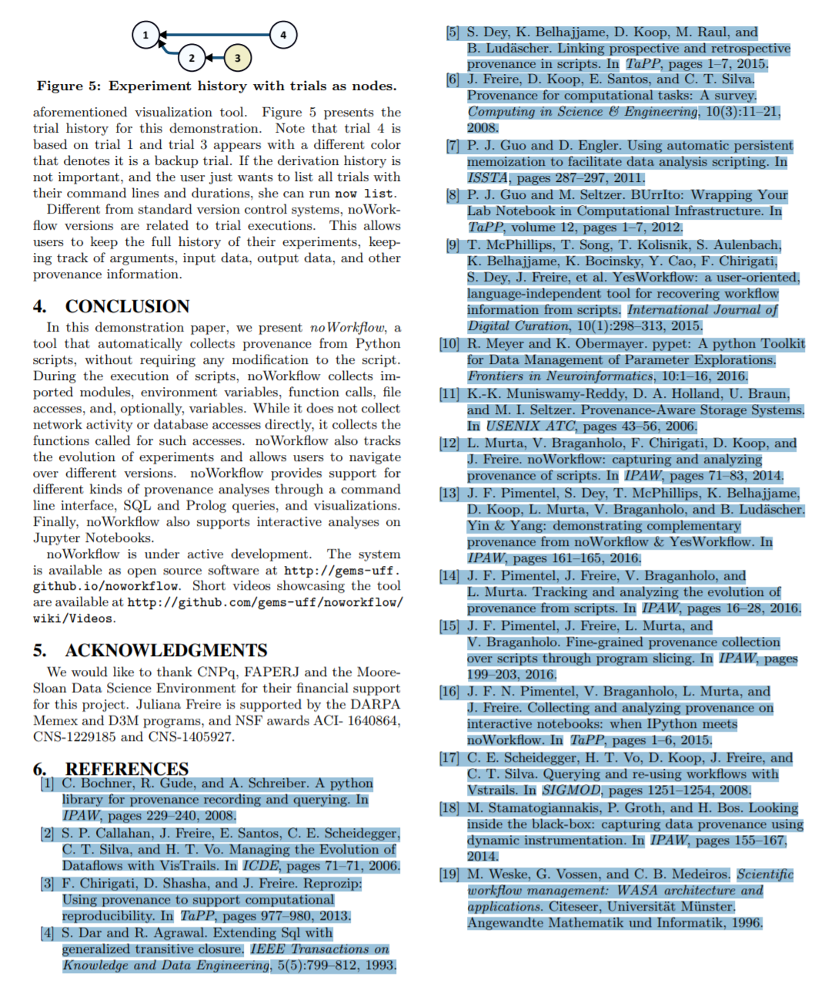
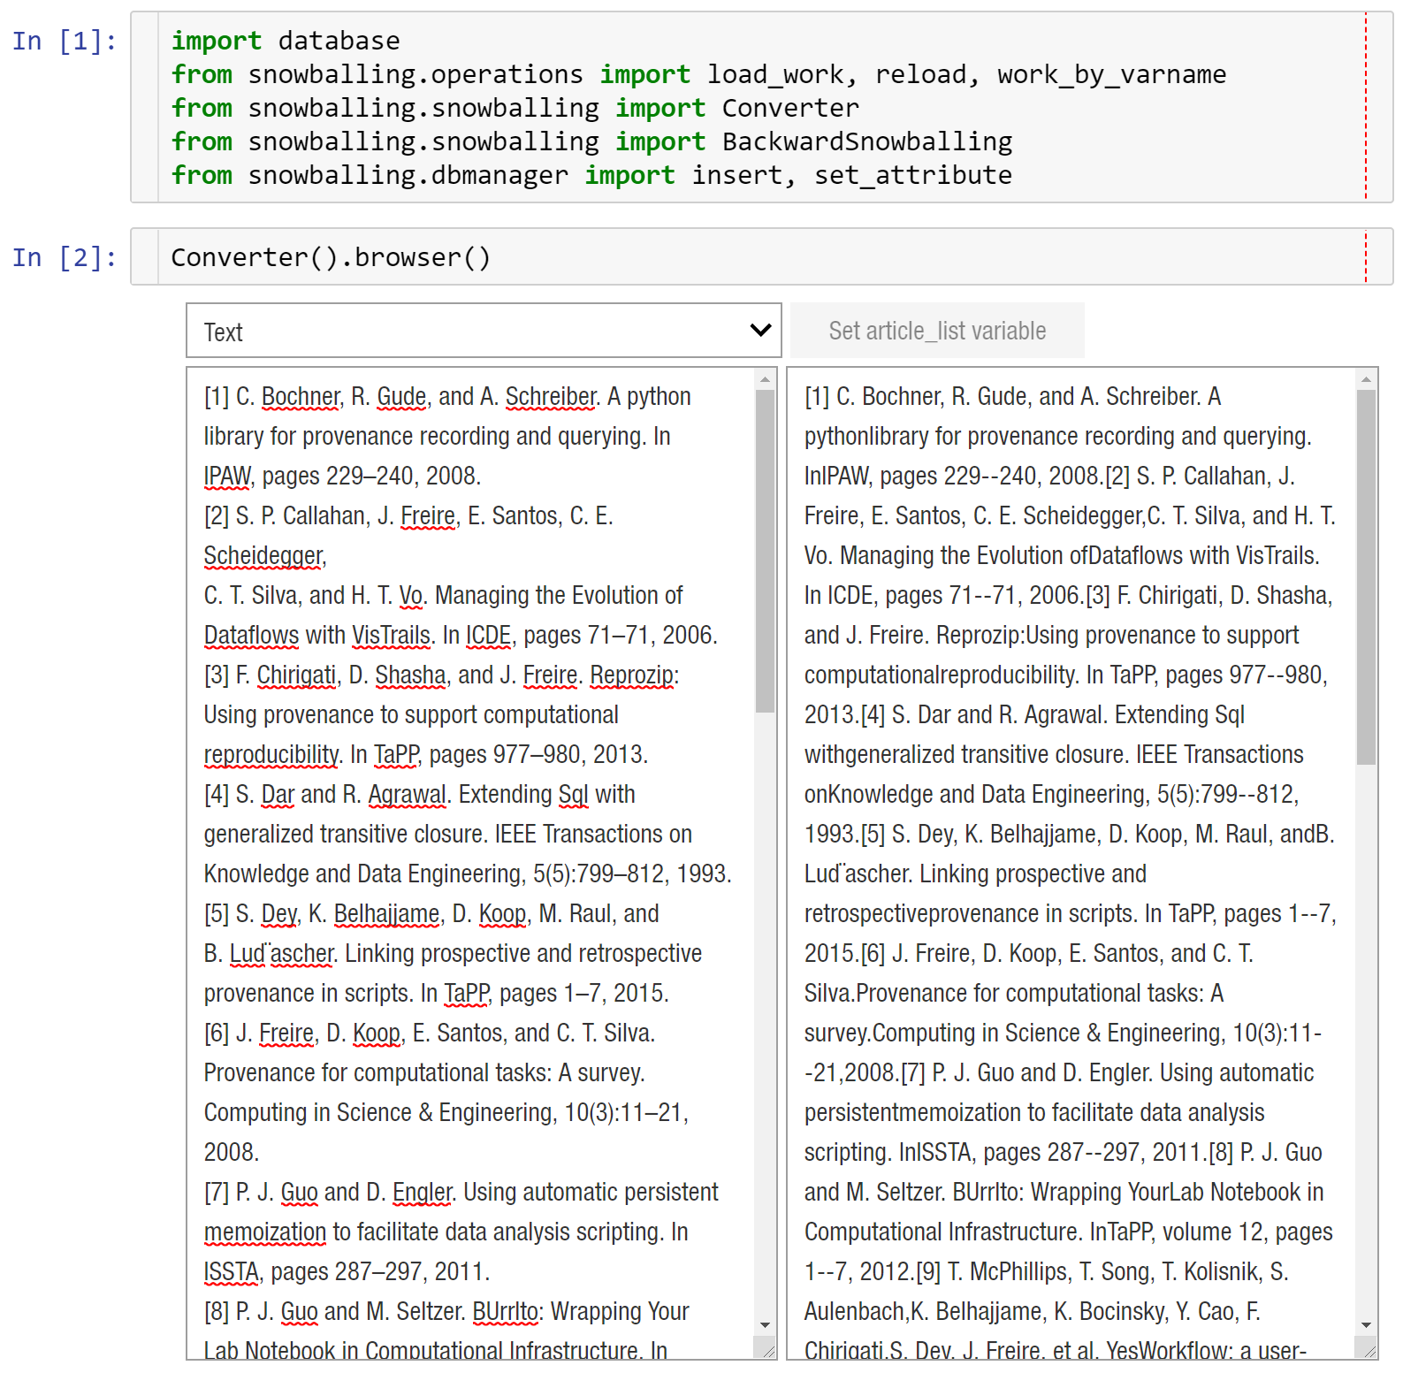
Backward.ipynb 1/4
1
2
4
3

Slide 40
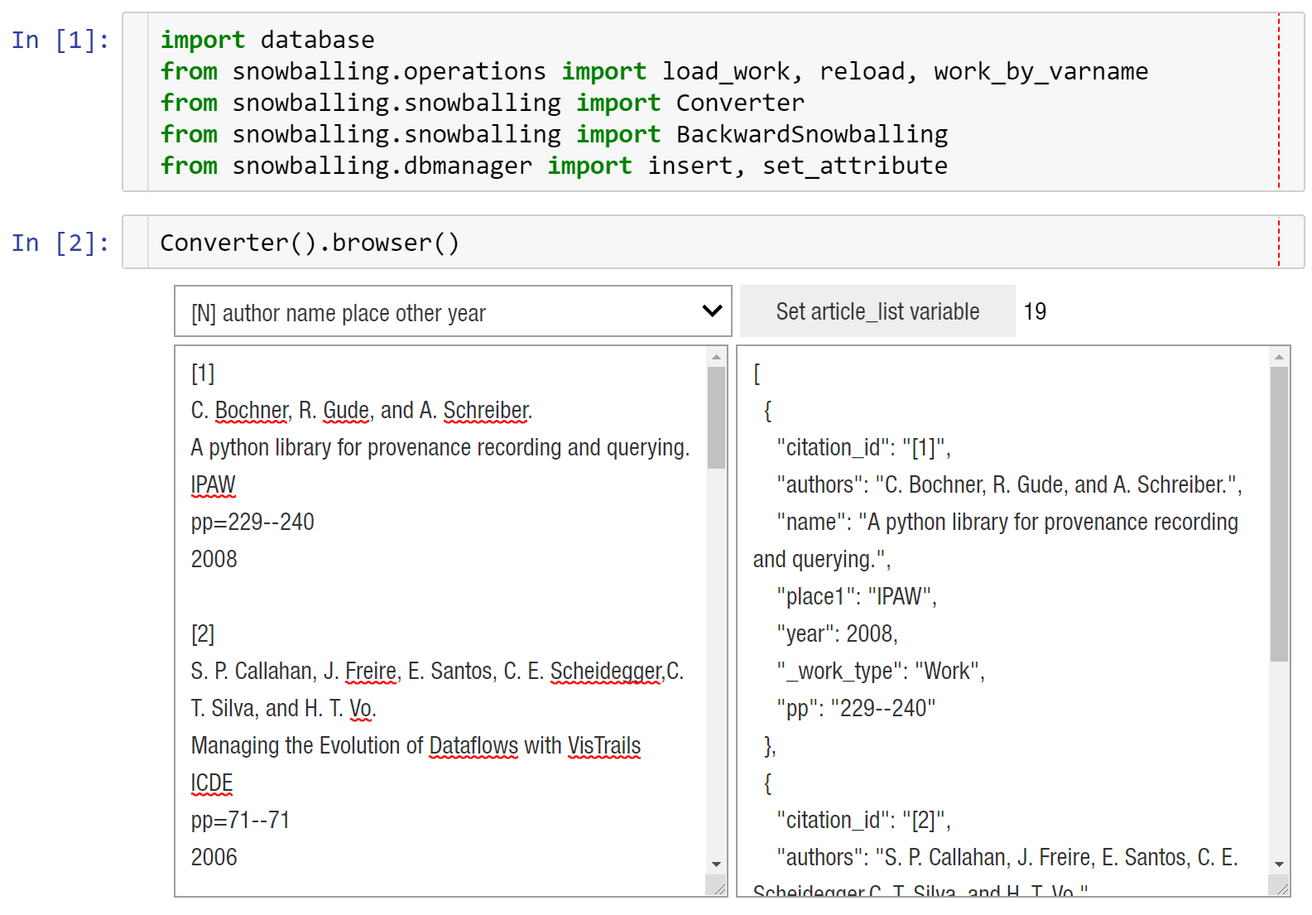
Backward.ipynb 2/4
2
1

Slide 41
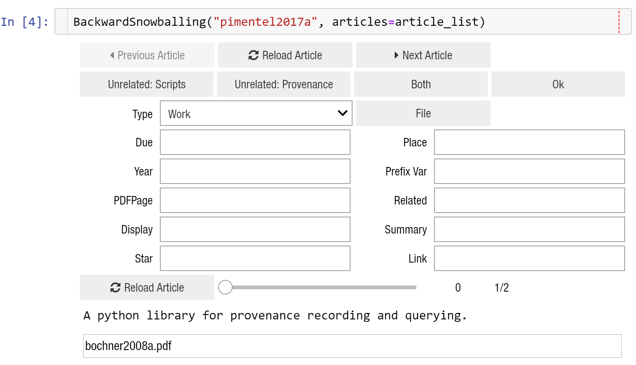
Backward.ipynb 3/4
1
2
3
5
4

Slide 42
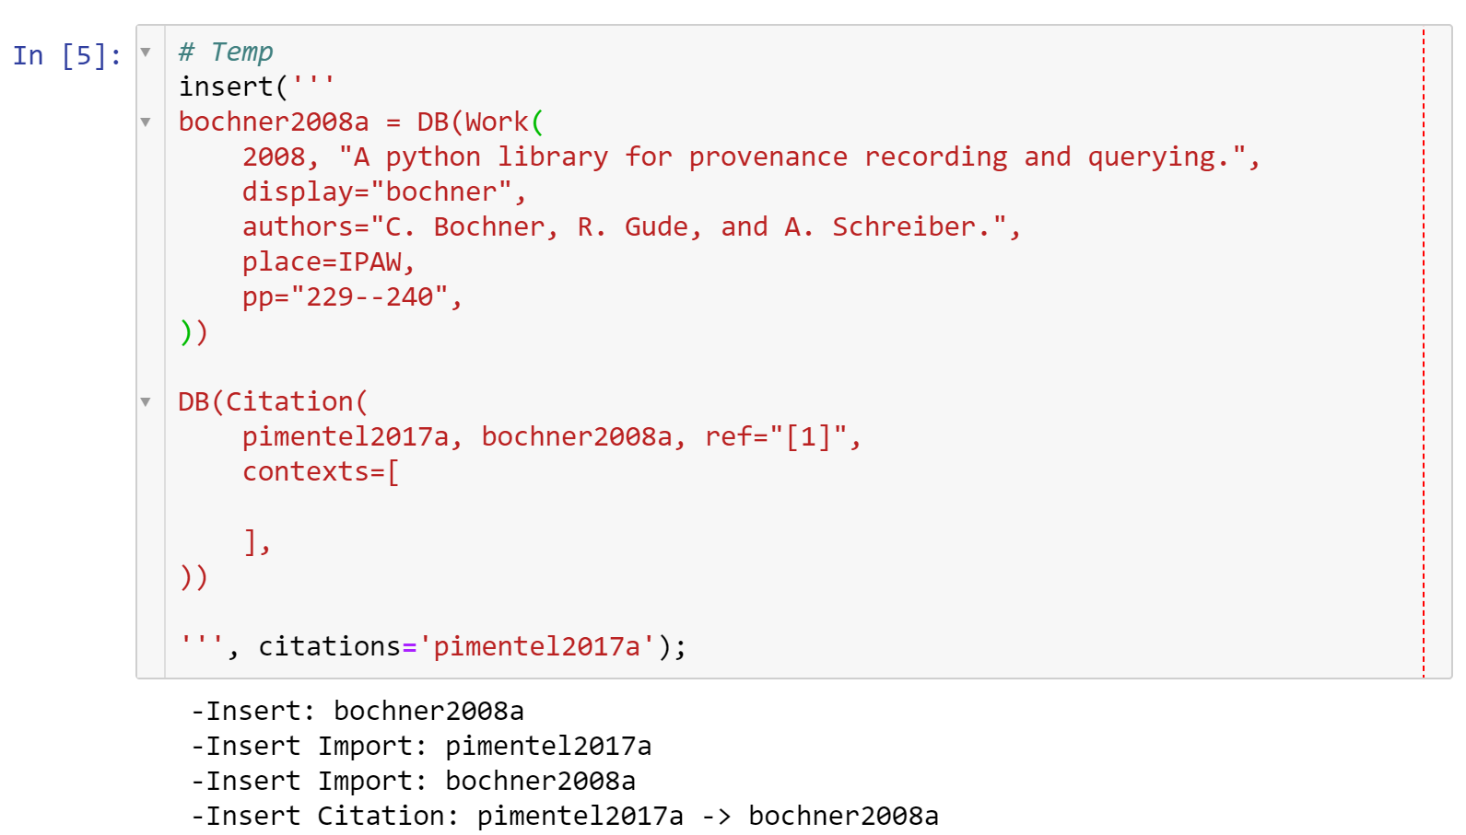
Backward.ipynb 4/4

Slide 43
Project Structure
database - Snowballing data storage
files - Papers’ PDF storage
notebooks - Analysis Notebooks
.gitignore - Ignores the files directory and Python cache files
Backward.ipynb - Supports Backward Snowballing
Forward.ipynb - Supports Forward Snowballing
Index.ipynb - Describes the Project Structure
Insert.ipynb - Supports the insertion of papers from BibTex
Progress.ipynb - Monitors the Snowballing progress
SearchScholar.ipynb - Supports the insertion of papers from Scholar
Validate.ipynb - Validates and updates the insertions

Slide 44
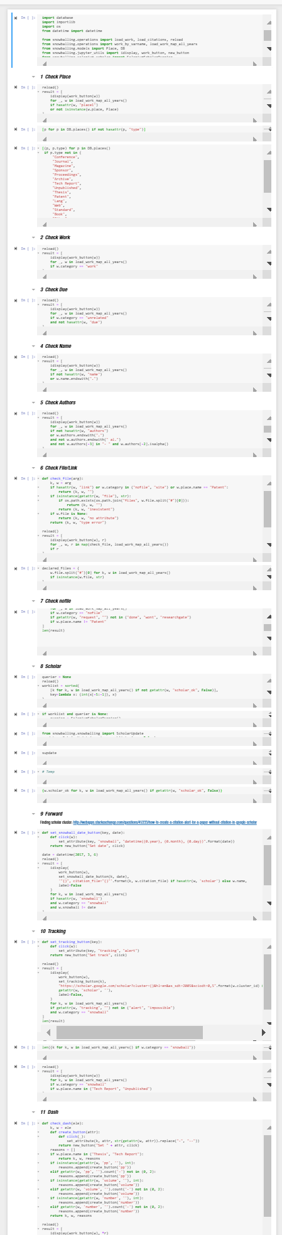
Validate.ipynb 1/3
Checks for place1
Checks for Work type
Checks for WorkUnrelated without “due=”
Checks for names ending with “.”
Verifies author format
Checks for non-existente files
Checks for WorkNoFile without “request”
Updates papers with data from scholar
Validates forward snowballing data
Check for WorkSnowball without alerts
Check for dash in the attributes “pp”, “volume”, “number”

Slide 45
Validate.ipynb 1/3
Checks for place1
Checks for Work type
Checks for WorkUnrelated without “due=”
Checks for names ending with “.”
Verifies author format
Checks for non-existente files
Checks for WorkNoFile without “request”
Updates papers with data from scholar
Validates forward snowballing data
Check for WorkSnowball without alerts
Check for dash in the attributes “pp”, “volume”, “number”

Slide 46
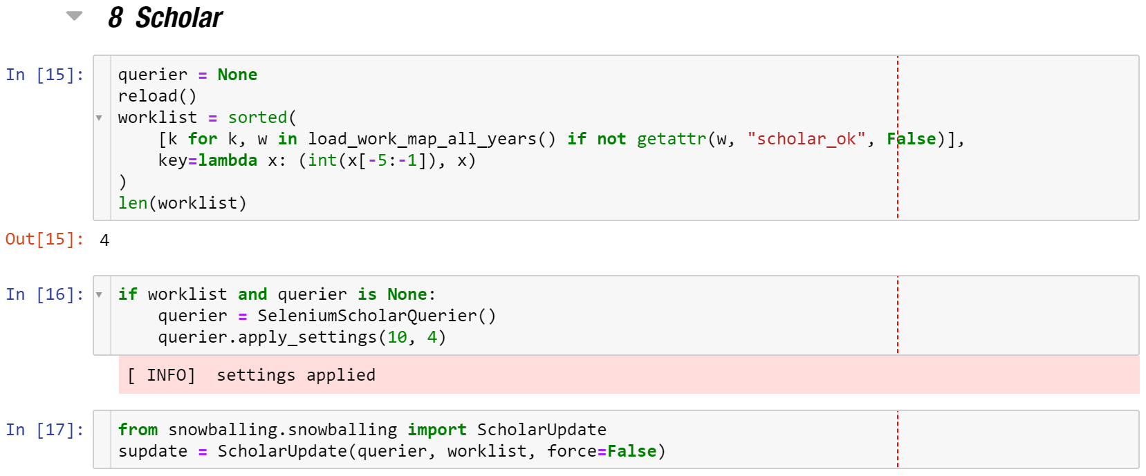
Validate.ipynb 2/3

Slide 47
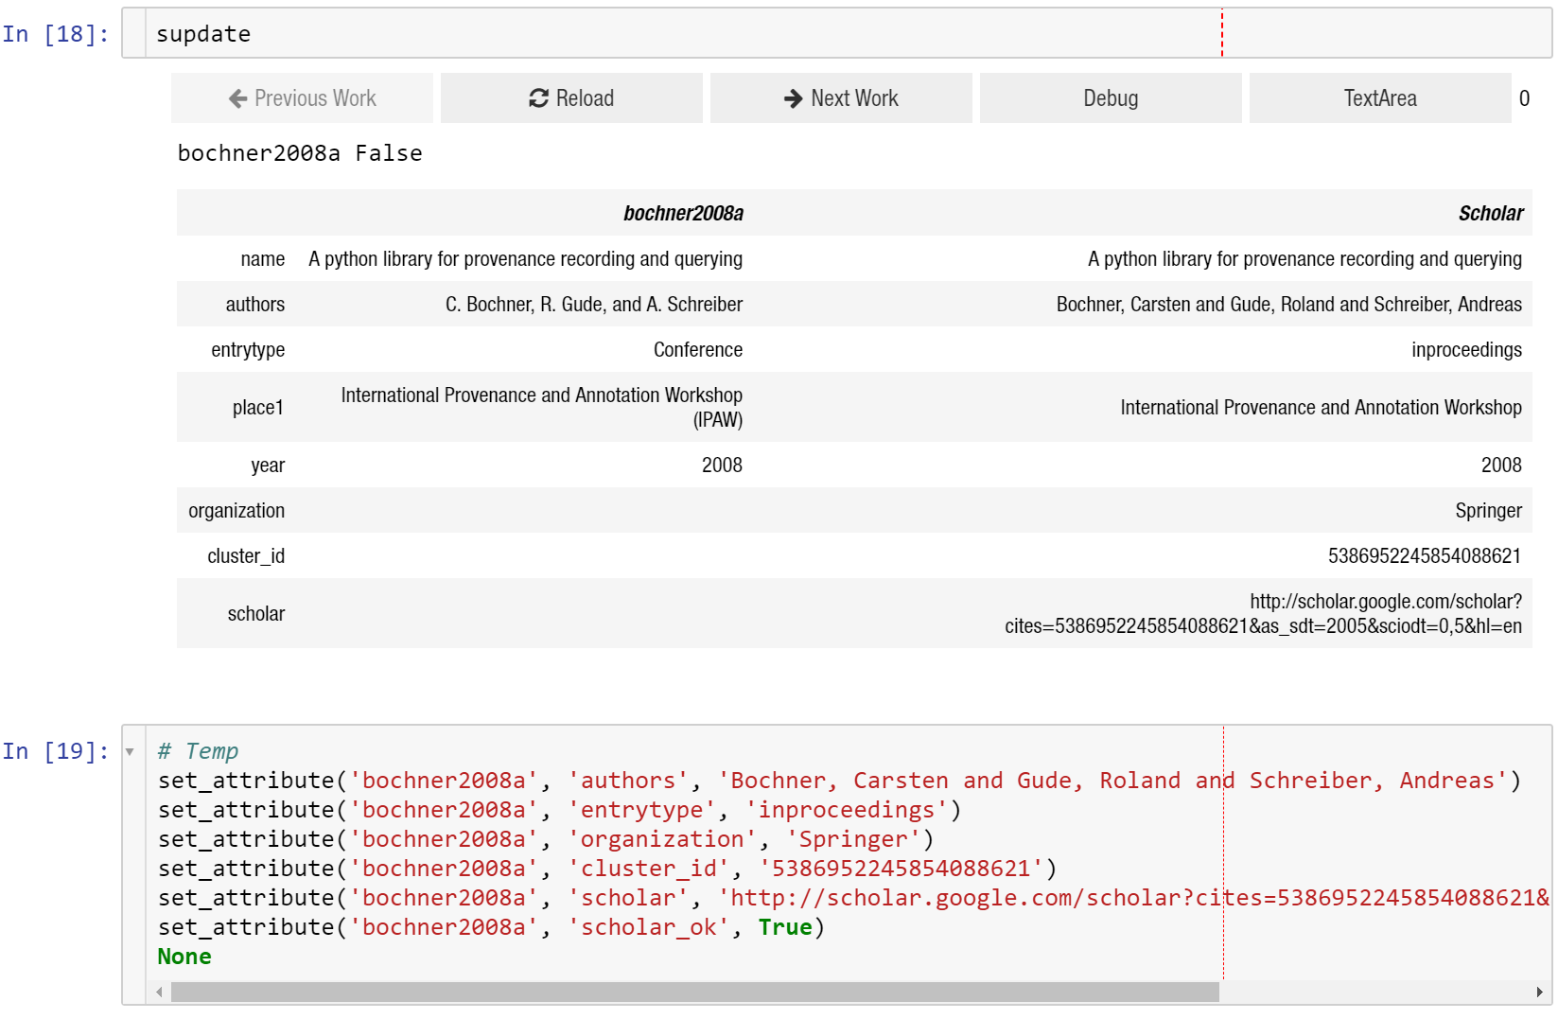
Validate.ipynb 3/3
1
2
4
3
5

Slide 48
Validate.ipynb 3/3
1
2
4
3
5

Slide 49
Project Structure
database - Snowballing data storage
files - Papers’ PDF storage
notebooks - Analysis Notebooks
.gitignore - Ignores the files directory and Python cache files
Backward.ipynb - Supports Backward Snowballing
Forward.ipynb - Supports Forward Snowballing
Index.ipynb - Describes the Project Structure
Insert.ipynb - Supports the insertion of papers from BibTex
Progress.ipynb - Monitors the Snowballing progress
SearchScholar.ipynb - Supports the insertion of papers from Scholar
Validate.ipynb - Validates and updates the insertions

Slide 50
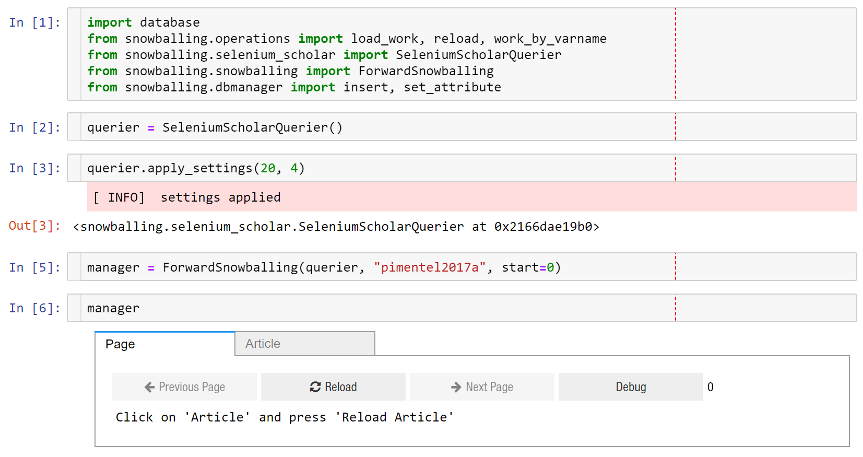
Forward.ipynb 1/3
1
2
3
4
5
6
7

Slide 51
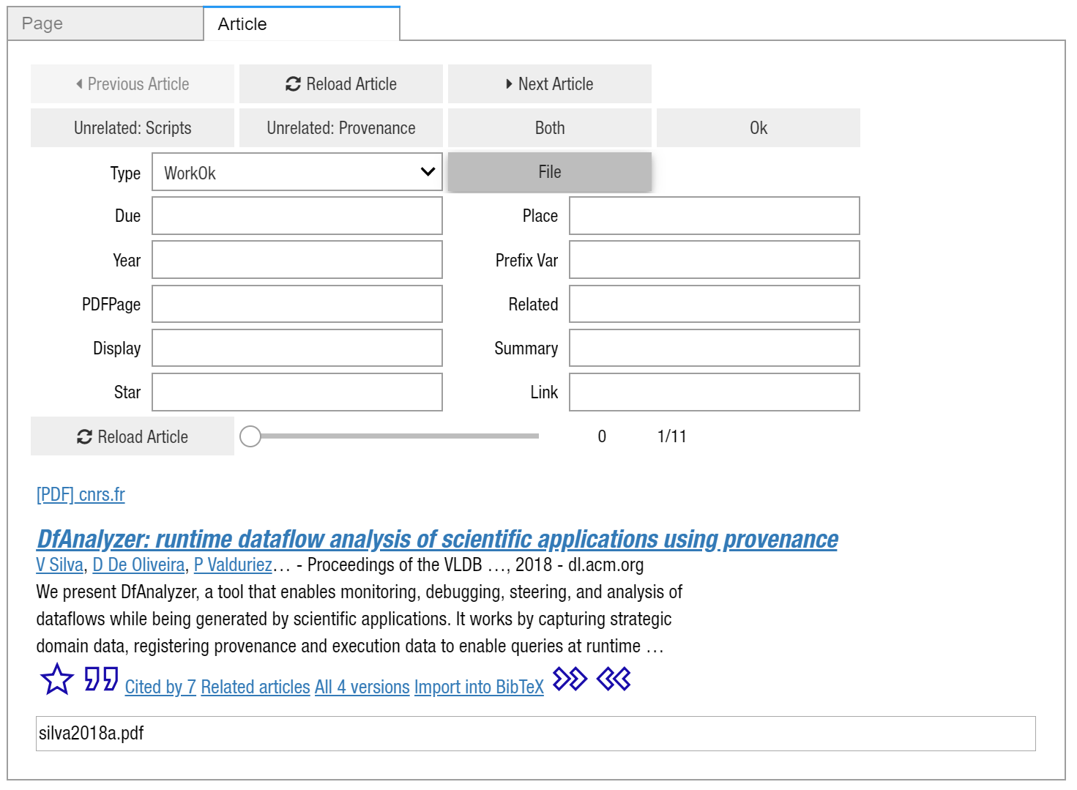
Forward.ipynb 2/3
1
2
3

Slide 52
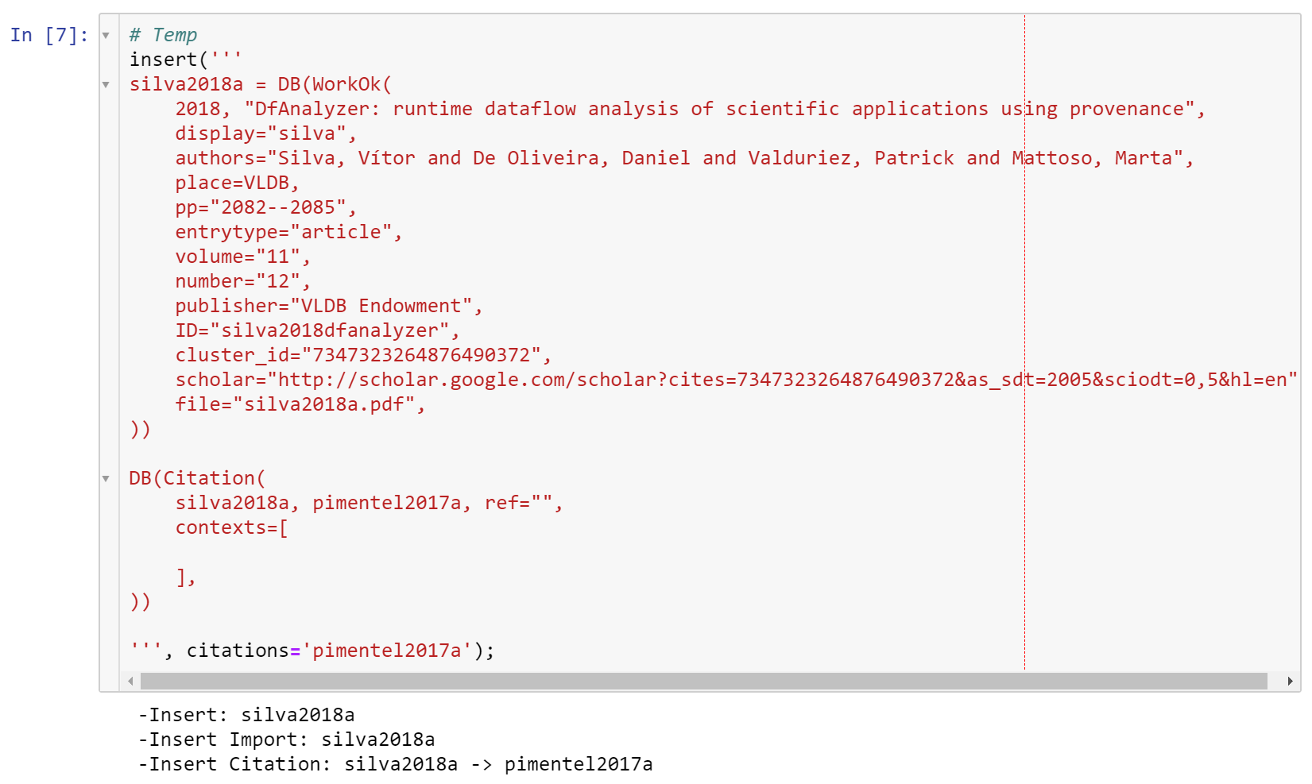
Forward.ipynb 3/3
1

Slide 53
Beware of the Google Scholar terms and conditions!
The scholar does not allow to use bots
The tool makes 21 requests to scholar to get the BibTex of papers for each resulting page
These request may trigger the Scholar bot detection
Pay attention to the Selenium window to fill the captachas
If a text field shows up asking for a captcha in the tool, fill the captcha in the Selenium window and type “<ok>” in the text field
If it is possible, sign in with a google account that is not your main one in the Selenium window

Slide 54
Project Structure
database - Snowballing data storage
files - Papers’ PDF storage
notebooks - Analysis Notebooks
.gitignore - Ignores the files directory and Python cache files
Backward.ipynb - Supports Backward Snowballing
Forward.ipynb - Supports Forward Snowballing
Index.ipynb - Describes the Project Structure
Insert.ipynb - Supports the insertion of papers from BibTex
Progress.ipynb - Monitors the Snowballing progress
SearchScholar.ipynb - Supports the insertion of papers from Scholar
Validate.ipynb - Validates and updates the insertions

Slide 55
Project Structure
database - Snowballing data storage
files - Papers’ PDF storage
notebooks - Analysis Notebooks
.gitignore - Ignores the files directory and Python cache files
Backward.ipynb - Supports Backward Snowballing
Forward.ipynb - Supports Forward Snowballing
Index.ipynb - Describes the Project Structure
Insert.ipynb - Supports the insertion of papers from BibTex
Progress.ipynb - Monitors the Snowballing progress
SearchScholar.ipynb - Supports the insertion of papers from Scholar
Validate.ipynb - Validates and updates the insertions

Slide 56
Notebooks Structure
output - Notebooks outputs
ApproachesHTML.ipynb - Exports HTML from approaches
Bibtex.SearchWork.ipynb - Queries work and exports BibTex
CitationGraph.ipynb - Generates citation graph
Place.ipynb - Generates histogram with publication places
SnowballingProvenance.ipynb - Describes the snowballing process

Slide 57
Notebooks Structure
output - Notebooks outputs
ApproachesHTML.ipynb - Exports HTML from approaches
Bibtex.SearchWork.ipynb - Queries work and exports BibTex
CitationGraph.ipynb - Generates citation graph
Place.ipynb - Generates histogram with publication places
SnowballingProvenance.ipynb - Describes the snowballing process

Slide 58
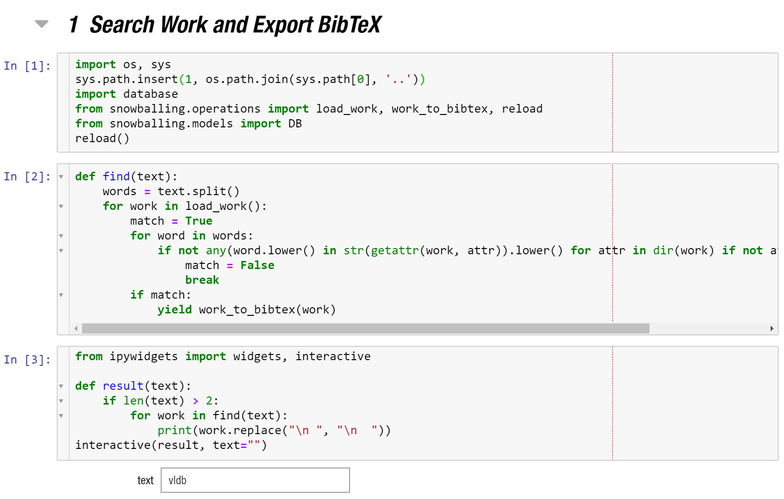
Bibtex.SearchWork.ipynb 1/2

Slide 59
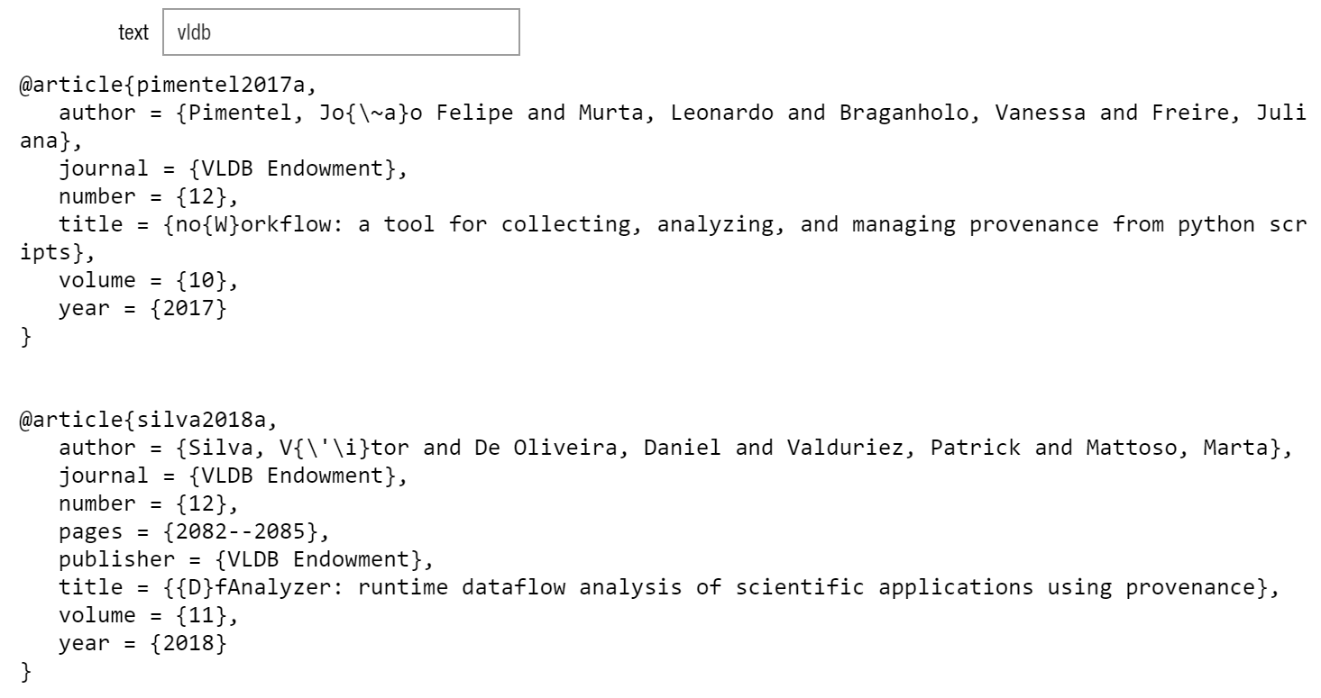
Bibtex.SearchWork.ipynb 2/2

Slide 60
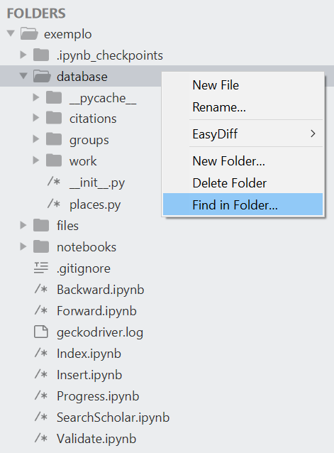
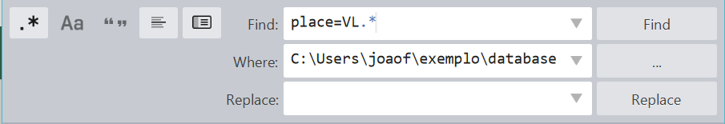
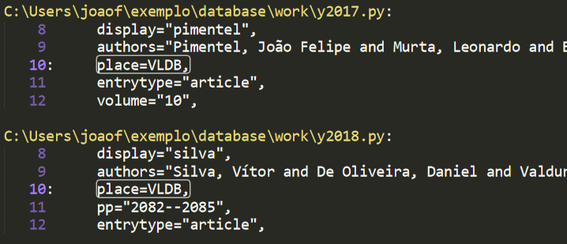
Busca Alternativa
2
1
3

Slide 61
Notebooks Structure
output - Notebooks outputs
ApproachesHTML.ipynb - Exports HTML from approaches
Bibtex.SearchWork.ipynb - Queries work and exports BibTex
CitationGraph.ipynb - Generates citation graph
Place.ipynb - Generates histogram with publication places
SnowballingProvenance.ipynb - Describes the snowballing process

Slide 62
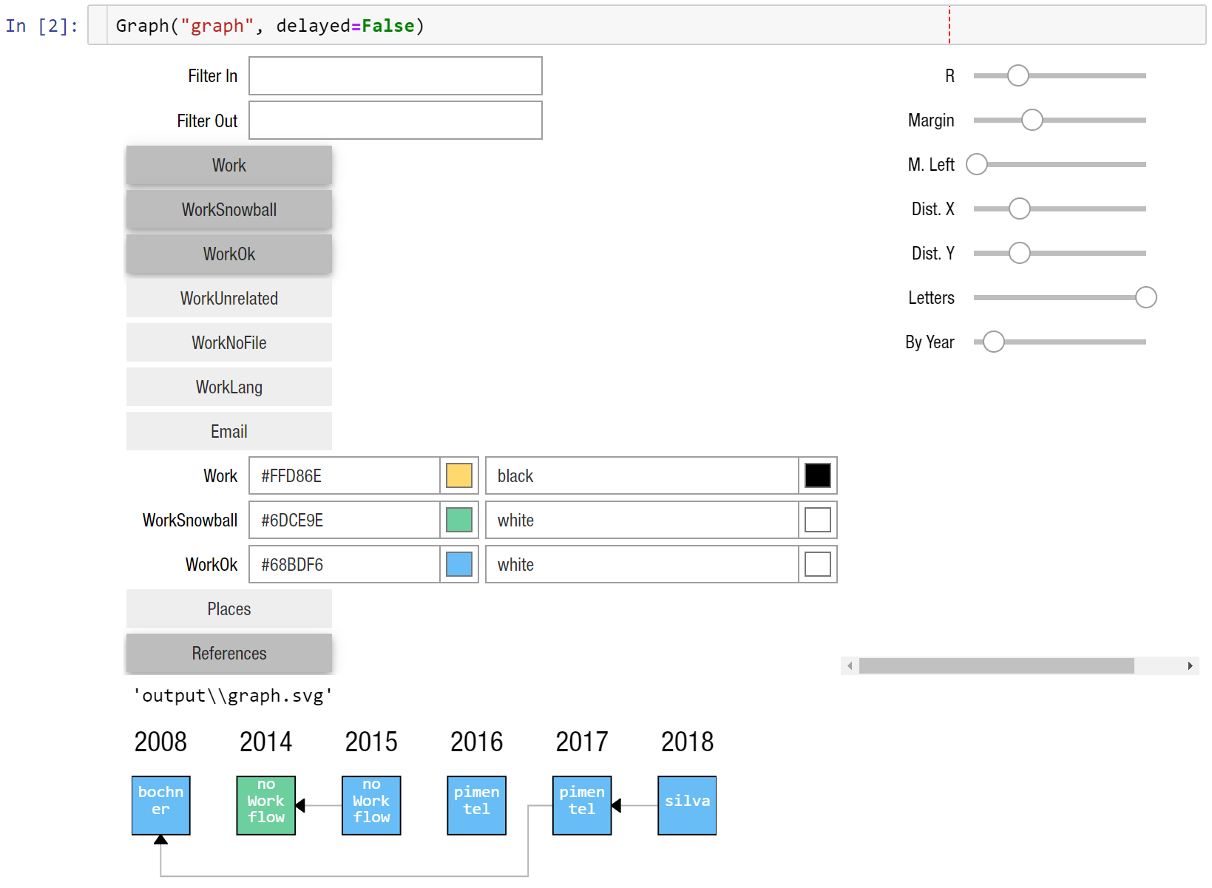
CitationGraph.ipynb

Slide 63
Notebooks Structure
output - Notebooks outputs
ApproachesHTML.ipynb - Exports HTML from approaches
Bibtex.SearchWork.ipynb - Queries work and exports BibTex
CitationGraph.ipynb - Generates citation graph
Place.ipynb - Generates histogram with publication places
SnowballingProvenance.ipynb - Describes the snowballing process

Slide 64
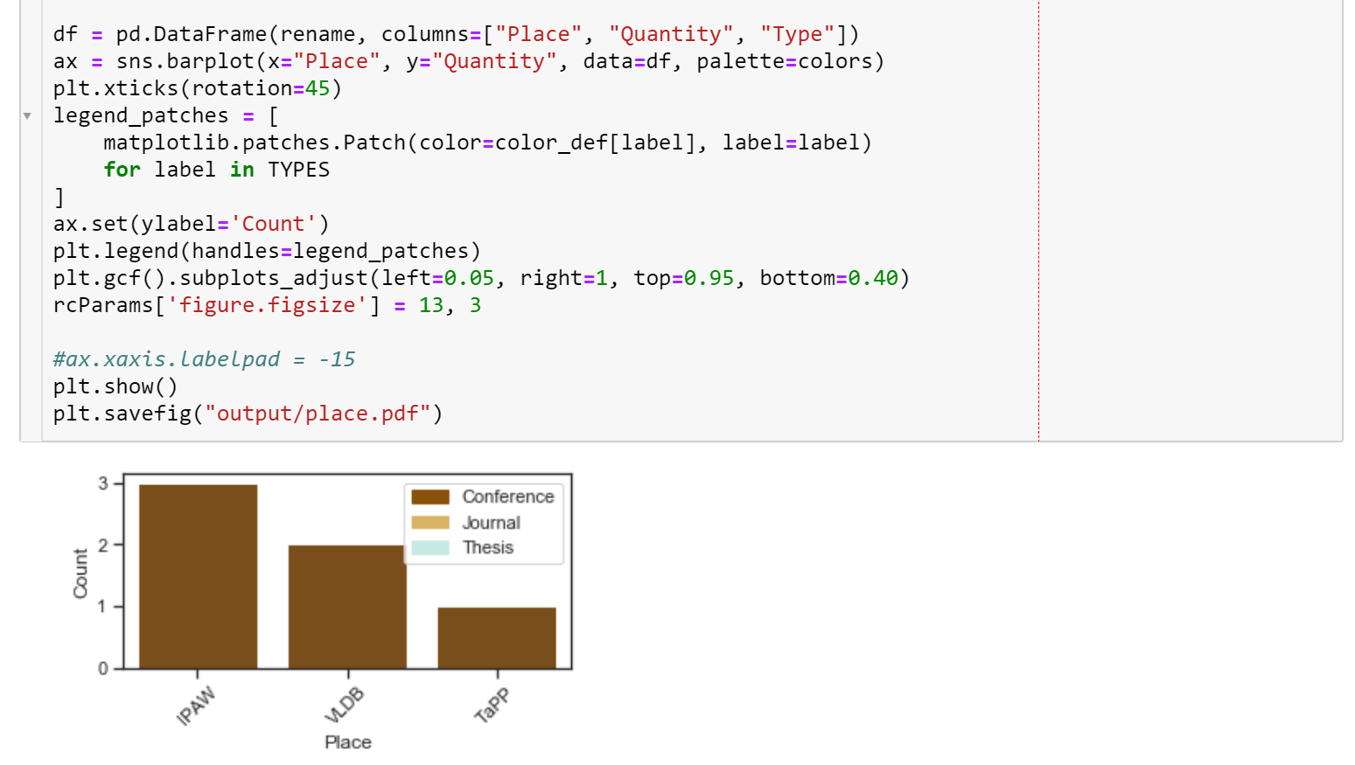
Place.ipynb

Slide 65
Notebooks Structure
output - Notebooks outputs
ApproachesHTML.ipynb - Exports HTML from approaches
Bibtex.SearchWork.ipynb - Queries work and exports BibTex
CitationGraph.ipynb - Generates citation graph
Place.ipynb - Generates histogram with publication places
SnowballingProvenance.ipynb - Describes the snowballing process

Slide 66
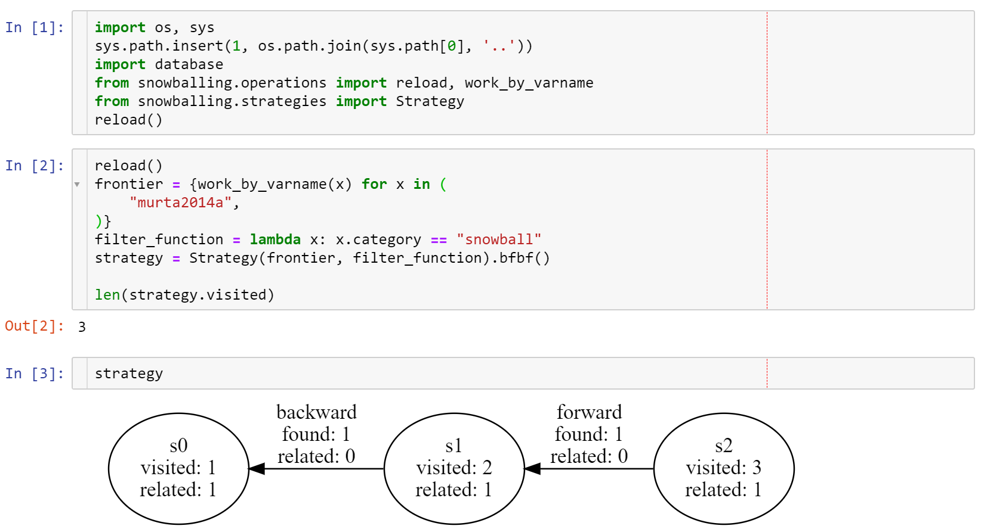
SnowballingProvenance.ipynb
.bb(): just BS
.ff(): just FS
.bbff(): all BS, followed by all FS
.ffbb(): all FS , followed by all BS
.s2bbff2u(): all BS and FS, in parallel
.bfbf(): alternates BS and FS
.fbfb(): alternates FS and BS
.sbfu(): BS and FS in parallel + union
Start set

Slide 67
Approaches
Groups papers to describe them together
database/groups - Storage
related - Related approaches
noworkflow.py - Sample approach. Remove it
constants.py - Constant definitions to prevent typos
unrelated.py - Write unrelated approaches in this file
notebooks - Analyses
ApproachesHTML.ipynb - Exports HTML based on _about

Slide 68
noworkflow.py Source Code
approach = Group(
murta2014a, pimentel2015a, pimentel2016a, pimentel2017a,
display="no Work flow",
approach_name="noWorkflow",
_cite=False,
_meta=[dict(
target=PYTHON,
)],
_about="""
<p>
noWorkflow (<a href="#murta2014a" class="reference">murta2014a</a>; <a href="#pimentel2015a" class="reference">pimentel2015a</a>) captures provenance from Python scripts.
</p>
""",
)

Slide 69
noworkflow.py Source Code
approach = Group(
murta2014a, pimentel2015a, pimentel2016a, pimentel2017a,
display="no Work flow",
approach_name="noWorkflow",
_cite=False,
_meta=[dict(
target=PYTHON,
)],
_about="""
<p>
noWorkflow (<a href="#murta2014a" class="reference">murta2014a</a>; <a href="#pimentel2015a" class="reference">pimentel2015a</a>) captures provenance from Python scripts.
</p>
""",
)
Work list
Replaces display attribute
Name for the approach analyses
Add \cite{varnames} when it uses approach_name

Slide 70
noworkflow.py Source Code
approach = Group(
murta2014a, pimentel2015a, pimentel2016a, pimentel2017a,
display="no Work flow",
approach_name="noWorkflow",
_cite=False,
_meta=[dict(
target=PYTHON,
)],
_about="""
<p>
noWorkflow (<a href="#murta2014a" class="reference">murta2014a</a>; <a href="#pimentel2015a" class="reference">pimentel2015a</a>) captures provenance from Python scripts.
</p>
""",
)
Approach annotations
HTML to be exported by notebook

Slide 71
Library 1/2
from snowballing import
approaches
Approach analysis functions
Group, GroupUnrelated, Item
get_approaches, name, wcite, wlatex_name, wcitea
dbindex
Functions that indicate where are each date in the “DB”
citation_file, year_file, places_file, this_file, parse_varname
dbmanager
Insert, rename, remove papers and citations
rename_citation, insert_citation, remove_source_citation, remove_target_citation, insert_work, rename_work, set_atribute, insert
graph
Configures and creates citation graph
Graph, create_graph
jupyter_utils
Buttons and cells for Jupyter
display_cell, idisplay, new_button, work_button
models
Data classes
Place, Work, Site, Email, Citation, Database
operations
Querying and access operations
reload, load_work, load_citations, load_work_map, work_by_varname, work_to_bibtex, find_citation, find
metakey, metakey_title

Slide 72
Library 2/2
from snowballing import
scholar
Original scholar.py library
selenium_scholar
Reimplementation of parts of scholar.py to use it with Selenium
SeleniumScholarQuerier, ScholarSettingsTask
get_scholar_url
utils
Extra functions
text_y, multiline_wrap, Point
import_or_reload, import_submodules
consume, setitem, match_any
snowballing
Widgets for the snowballing phase
Converter: Insert.ipynb, Backward.ipynb
ArticleNavigator: Todos
BackwardSnowballing: Backward.ipynb
ForwardSnowballing: Forward.ipynb
ScholarUpdate: Validate.ipynb
SearchScholar: SearchScholar.ipynb
strategies
Process analysis
State, Strategy

Slide 73
Snowballing Tool
https://github.com/JoaoFelipe/snowballing
João Felipe Pimentel

